Slide 1
Residual Networks
and
Analyses
He, Kaiming, et al. "Deep Residual Learning for Image Recognition." arXiv preprint arXiv:1512.03385 (2015).
Andreas el. al. "Residual Networks are Exponential Ensembles of Relatively Shallow Networks." arXiv (2016).
Zagoruyko, Sergey, and Nikos Komodakis. "Wide Residual Networks." arXiv (2016).

Slide 2
Deep residual networks
152 layers network
1st place on ILSVRM 2015 classification task
1st place on ImageNet detection
1st place on ImageNet localization
1st place on COCO detection
1st place on COCO segmentation

Slide 3
Deeper Network?
Is deeper network always better?
What about vanishing/exploding gradients?
Better initialization methods / batch normalization / ReLU
Any other problems?
Overfitting?
Degradation problem: more depth but lower performance

Slide 4
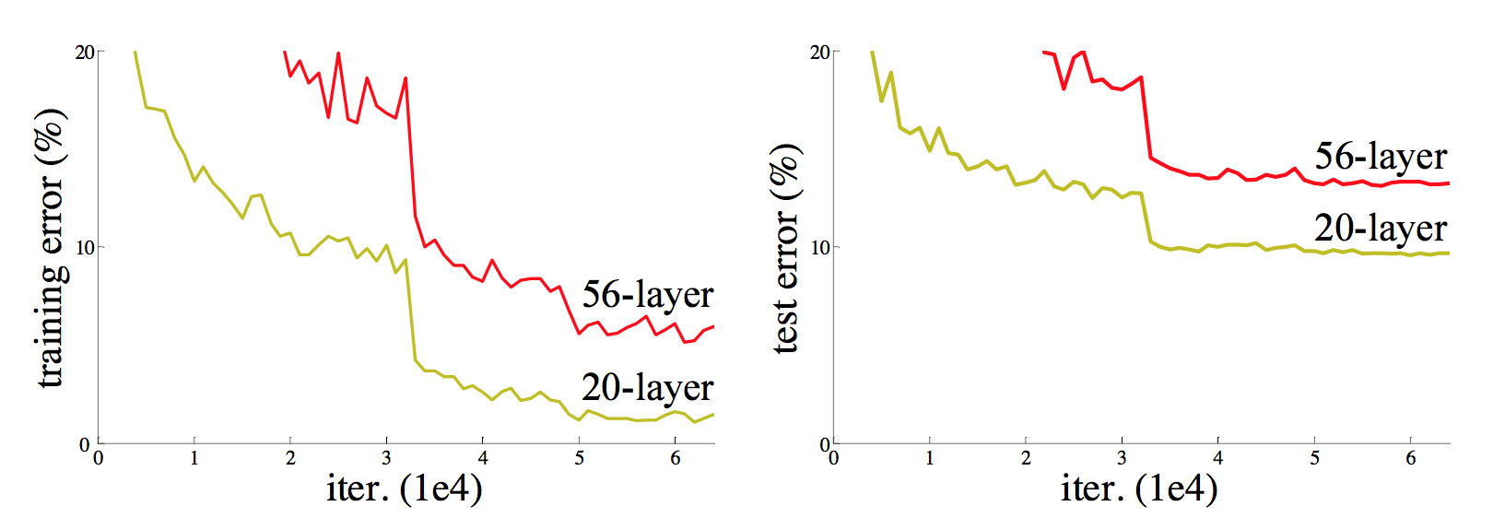
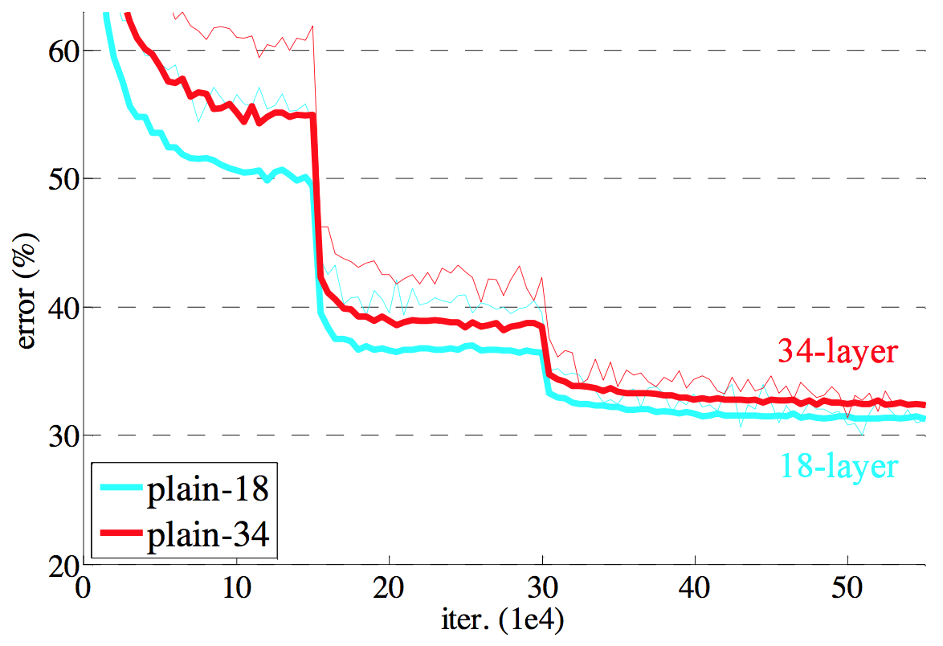
Degeneration problem
CiFAR 100 Dataset
ImageNet

Slide 5
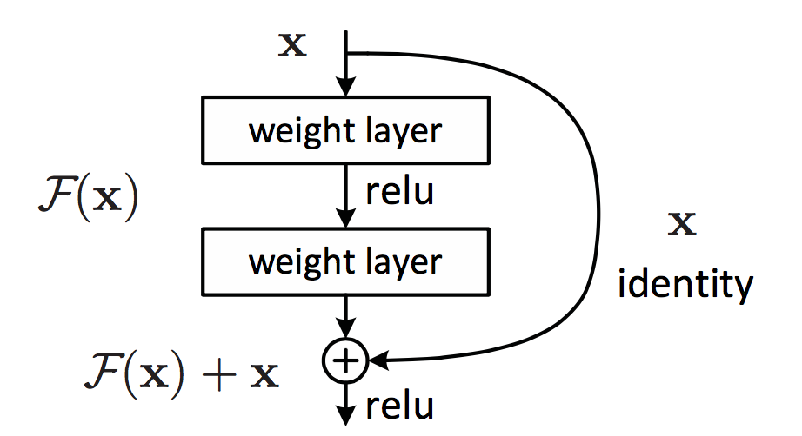
Residual learning building block

Slide 6
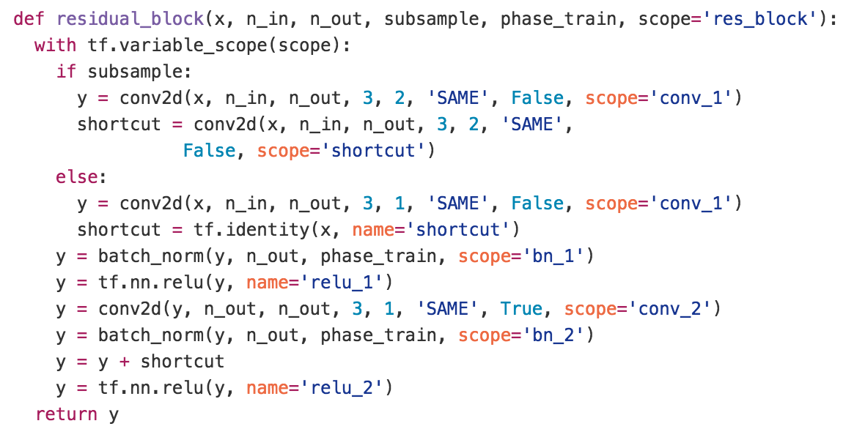
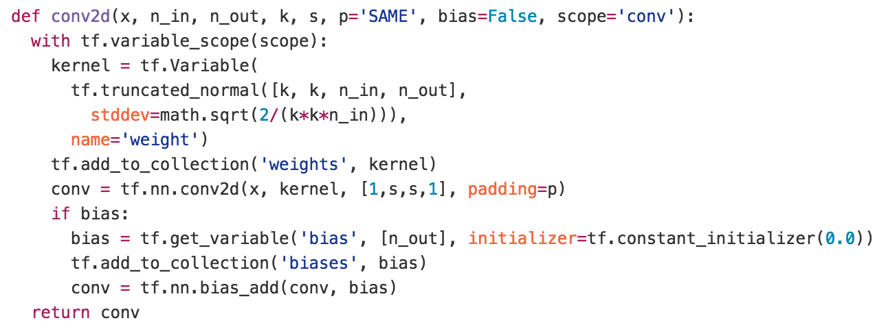
Residual learning building block
y
ReLU
+
y
conv2d
y
ReLU
y
conv2d
x

Slide 7
Why residual?
We hypothesize that it is easier to optimize the residual mapping than to optimize the original, unreferenced mapping.
Shortcut connections are used.

Slide 8
Why residual?
“The extremely deep residual nets are easy to optimize. “
“The deep residual nets can easily enjoy accuracy gains from greatly increased depth, producing results substantially better than previous networks. “

Slide 9
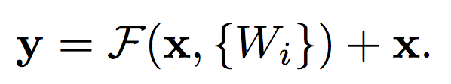
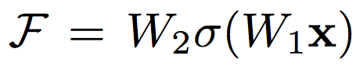
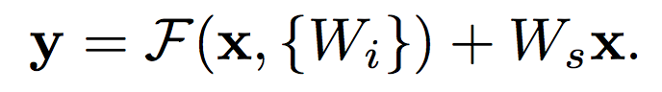
Residual mapping
Basic residual mapping (same dim.)
“But we will show by experiments that the identity mapping is sufficient for addressing the degradation problem and is economical, and thus W is only used when matching dimensions.”
Basic residual mapping (different dim.)

Slide 10
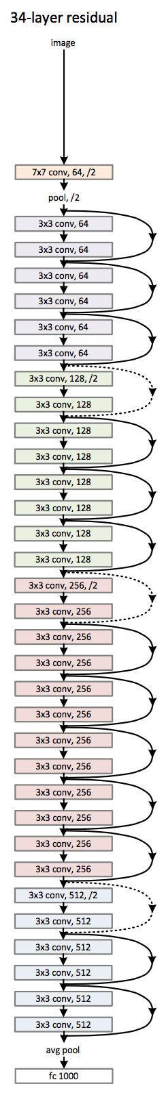
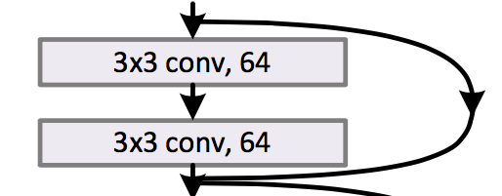
Deep residual network

Slide 11
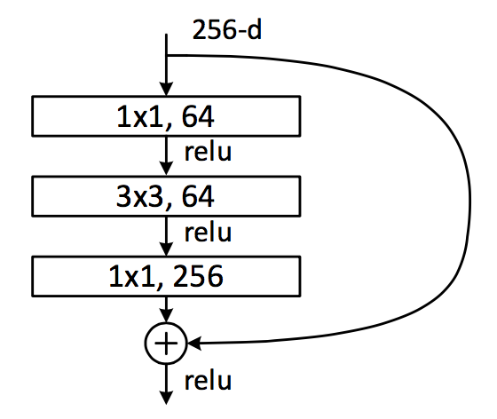
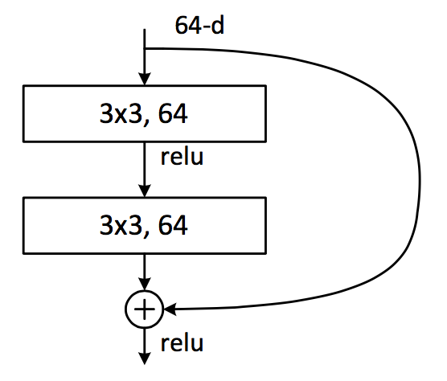
Deeper bottle architecture
Dimension reduction
Convolution
Dimension increasement

Slide 12
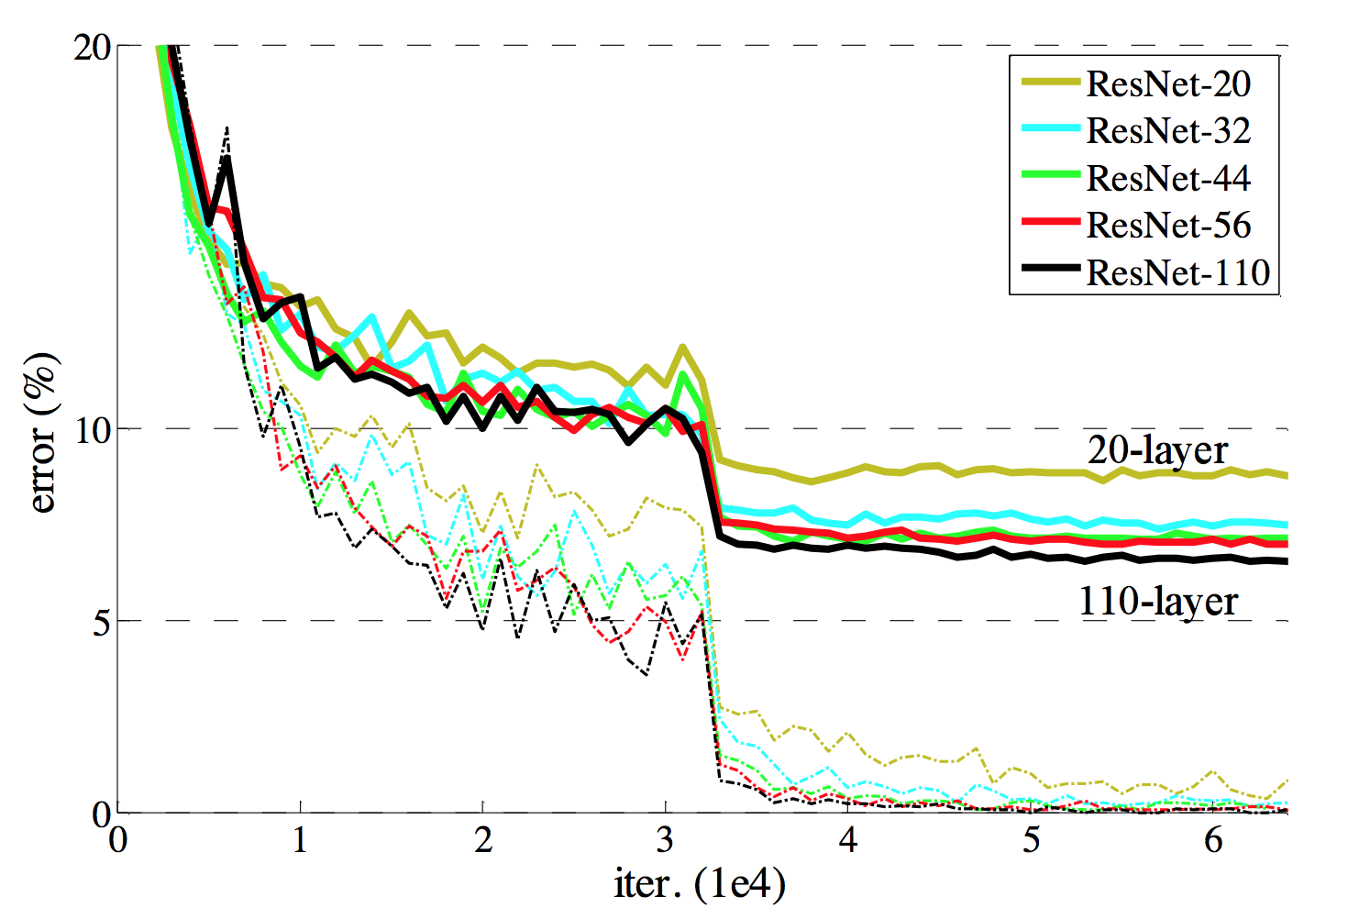
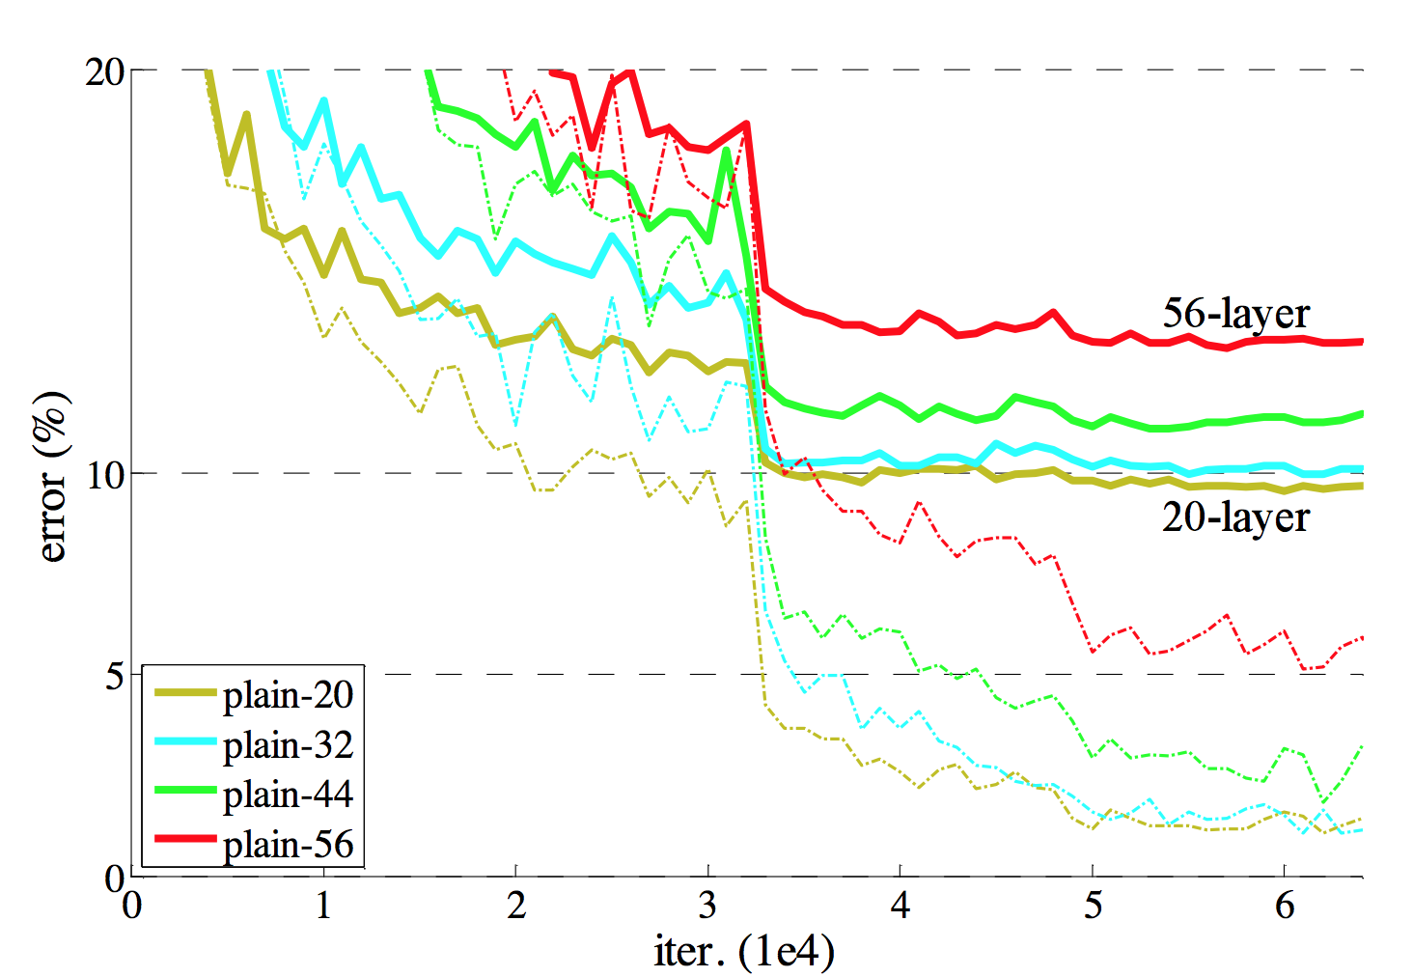
Experimental results

Slide 13
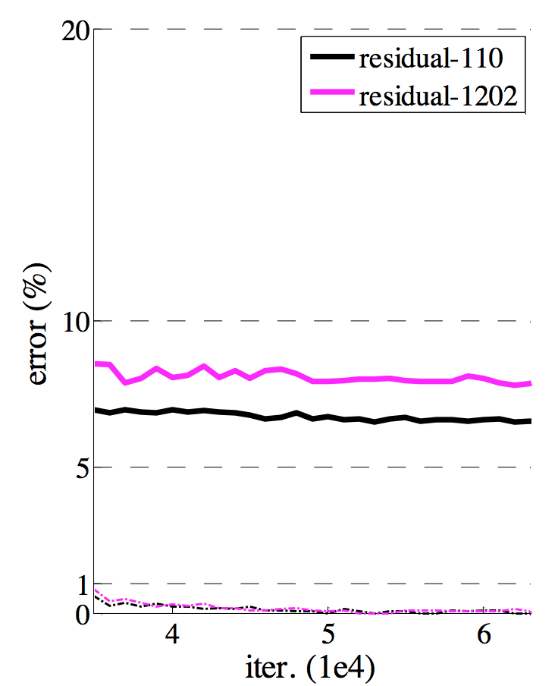
Experimental results

Slide 14

ResNet is an ensemble model
Andreas el. al. "Residual Networks are Exponential Ensembles of Relatively Shallow Networks." arXiv (2016).

Slide 15
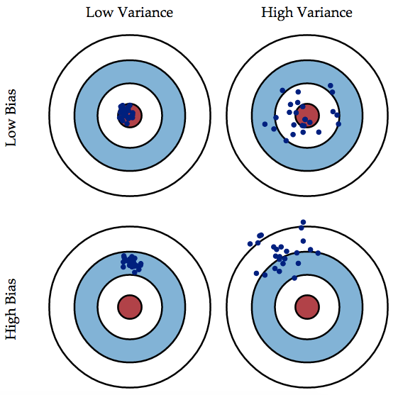
Ensemble model?
Bagging
Boosting
The Famous Bias/Variance Tradeoff

Slide 16
Bagging vs. Boosting
Bagging
Generate multiple sets of training data (with bootstrapping), multiple predictions and combine them with averaging prediction
Reduce overall variance using multiple low-bias models
Example: Random Forest
Bagging
Boosting
Boosting
Generate multiple weak learners and combine them to make a strong learner
Reduce overall bias using multiple weak learners
Example: Boosting, AdaBoost

Slide 17
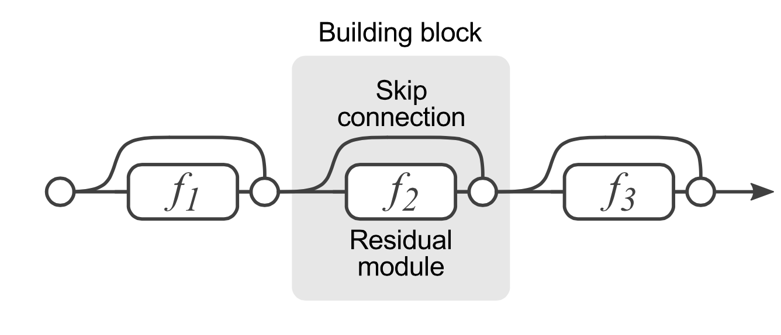
ResNet is an ensemble model?

Slide 18
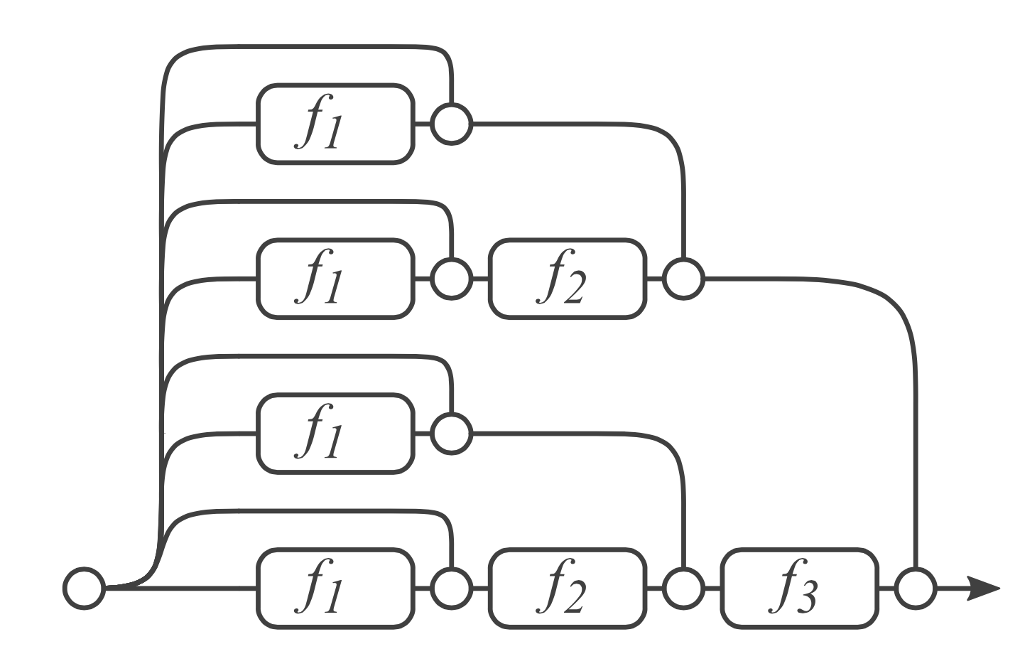
ResNet is an ensemble model?

Slide 19
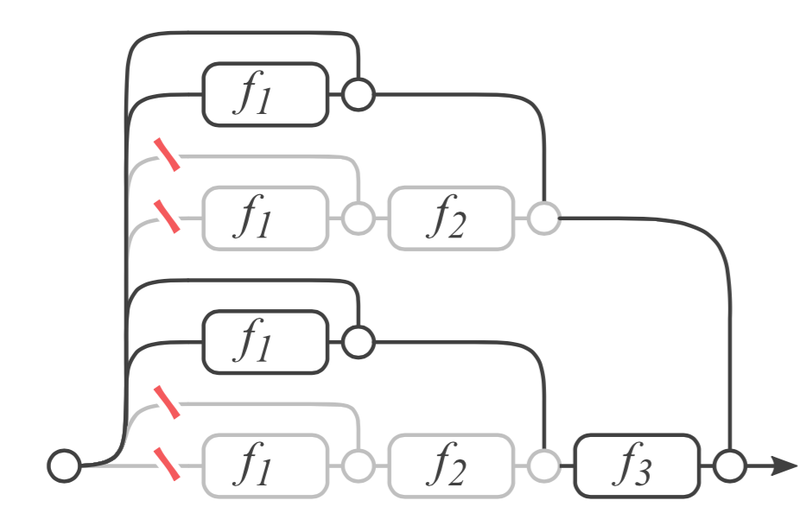
Remove a layer?
What happens if we remove the second layer?

Slide 20
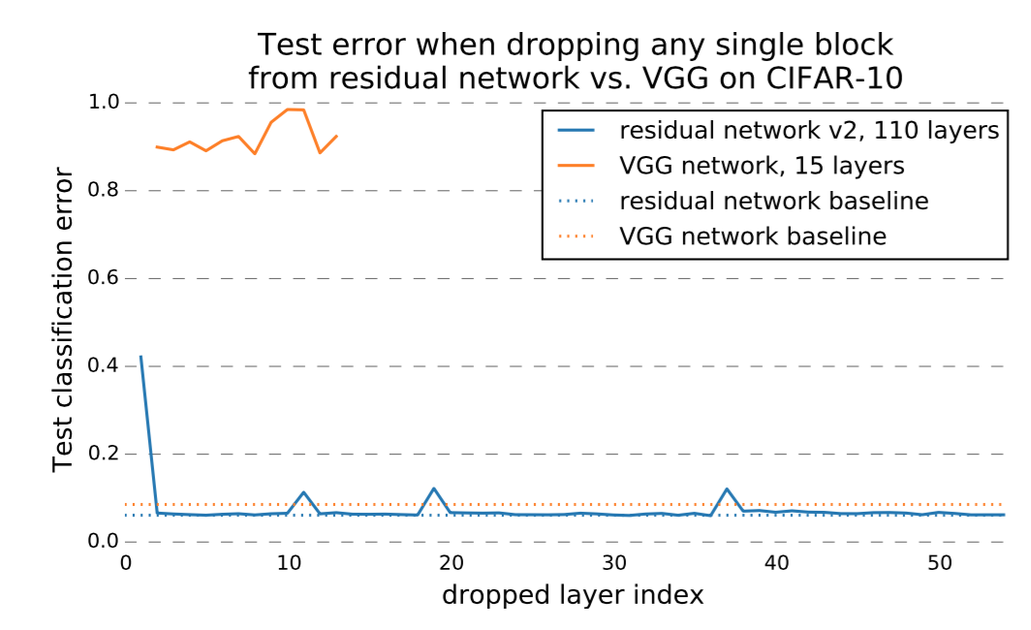
Performance?

Slide 21
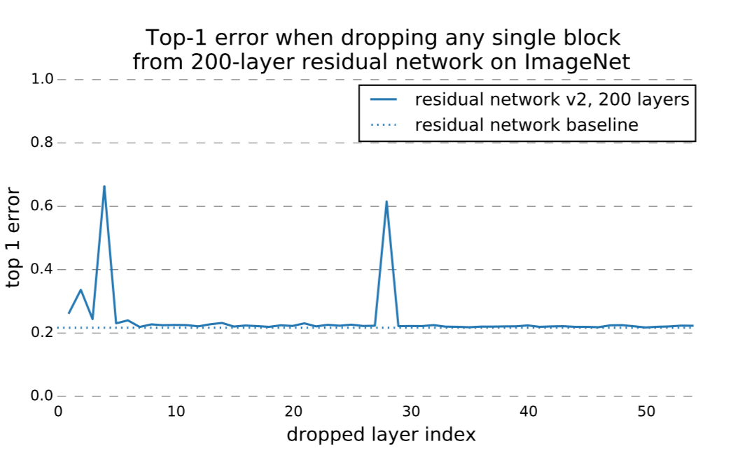
Performance?

Slide 22
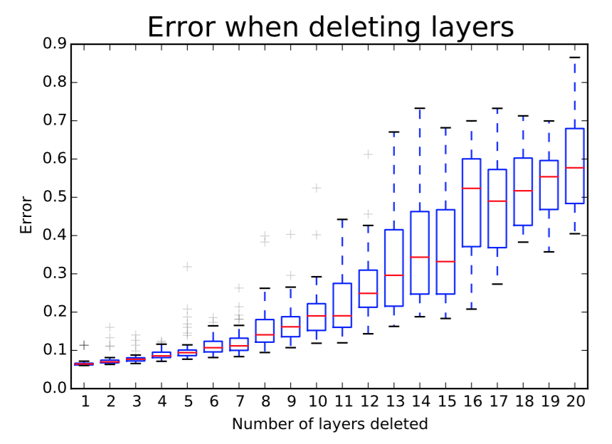
Removing multiple layers?

Slide 23
What does this mean?
“One of the characteristics of ensembles is that their performance depends smoothly on the number of members. …. This means error should decrease smoothly as we delete more residual modules. “

Slide 24
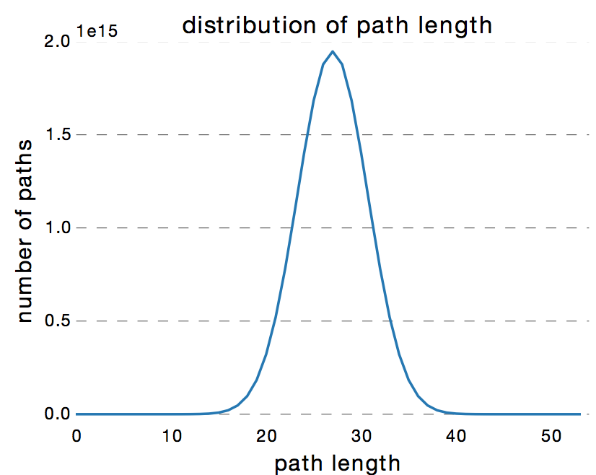
Ensemble of shallow nets?
Path distribution follows a Binomial distribution.
More than 95% of paths go through 19 to 35 modules.

Slide 25
Depth is NOT that important
Zagoruyko, Sergey, and Nikos Komodakis. "Wide Residual Networks." arXiv (2016).

Slide 26
Depth vs. width
“The authors of residual networks tried to make them as thin as possible in favor of increasing their depth and having less parameters, and even introduced a «bottleneck» block which makes ResNet blocks even thinner.”
“We note, however, that the residual block with identity mapping that allows to train very deep networks is at the same time a weakness of residual networks. As gradient flows through the network there is nothing to force it to go through residual block weights and it can avoid learning anything during training, so it is possible that there is either only a few blocks that learn useful representations, or many blocks share very little information with small contribution to the final goal.”

Slide 27
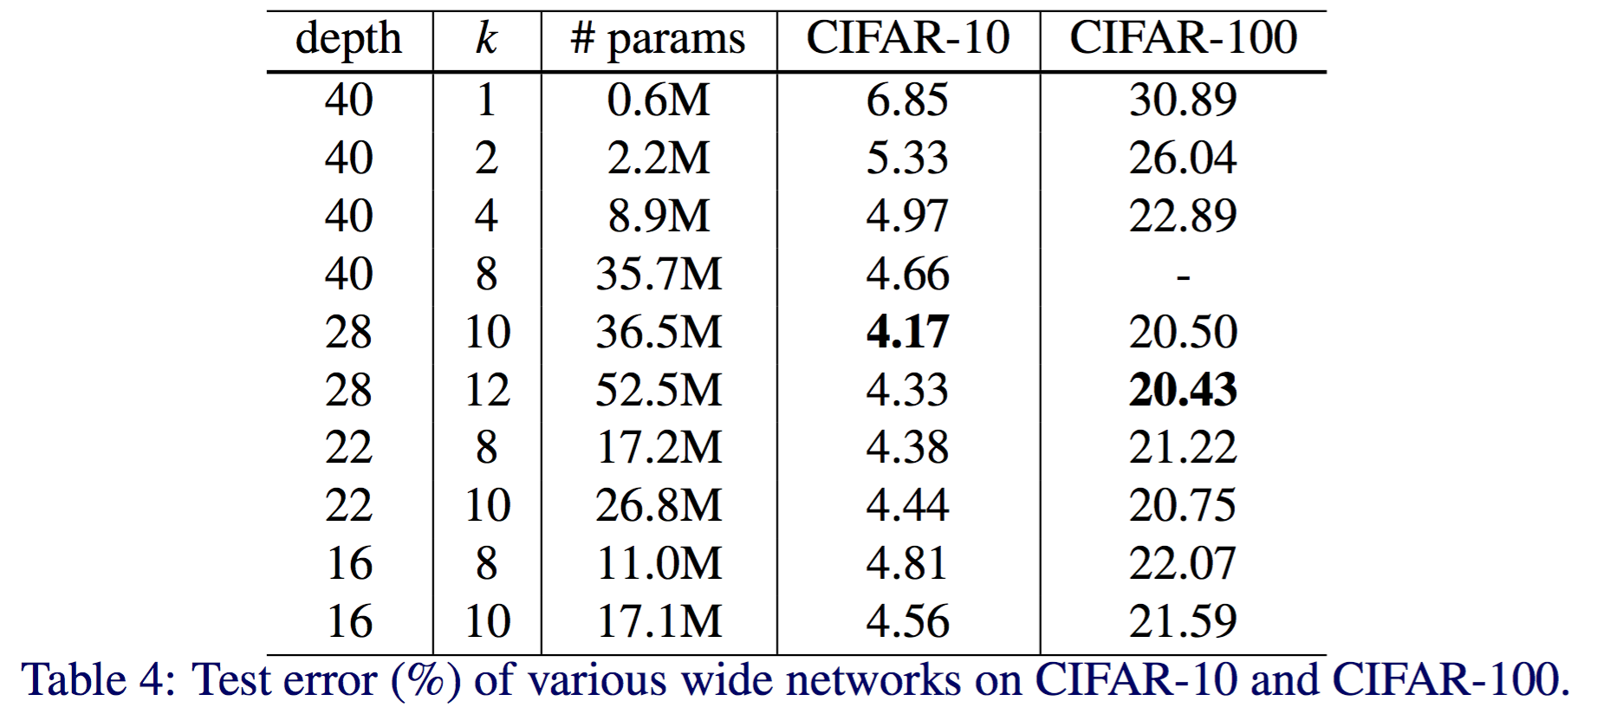
Experimental results

Slide 28
Experimental results

Slide 29
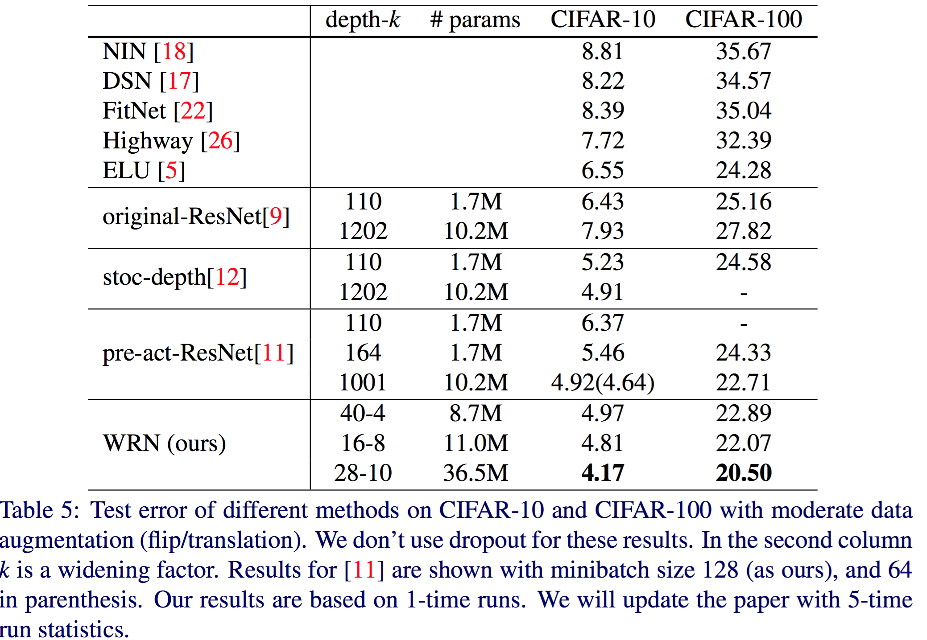
Experimental results
8 times faster to train

Slide 30
Experimental results

Slide 31
Summary
Widening consistently improves performance across residual networks of different depth
Increasing both depth and width helps until the number of parameters becomes too high and stronger regularization is needed
Wide networks can successfully learn with a 2 or more times larger number of parameters than thin ones, which would re-quire doubling the depth of thin networks, making them infeasibly expensive to train.

